Slide 1

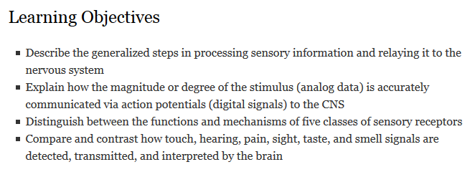
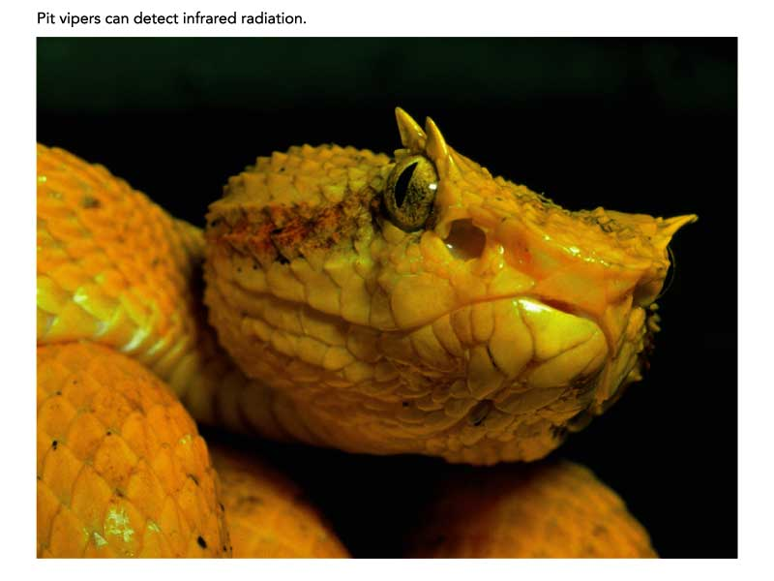
Sensory Mechanisms
Sensory receptors
Touch, sound, pain, sight, taste, and smell
Notes:
http://media.pearsoncmg.com/bc/bc_freeman_biosci_3/web_animations/vertebrate_eye/46_A01.swf

Slide 2
Key Concepts
Sensory receptor cells transduce external stimuli into changes in membrane potential
Sensory receptor cells can be
specialized neurons (the receptor is a neuron)
specialized sensory cells which synapse with neurons (the receptor secretes neurotransmitters to a neuron)
Stimuli are integrated in the CNS and responses are sent to appropriate body systems

Slide 3
Processing Sensory Information
Transduction (conversion to action potential)
Amplification of signal within sensory cell
Transmission to the CNS
Signals from different sensory systems transmit signals to different parts of the brain
Integration in the CNS
Incoming signals are integrated at the axon hillock via summation of potentials from many receptors
Sensory adaptation is an important form of integration, in which continued stimulation results in a decrease in responsiveness (you stop noticing that you’re wearing clothes after a while)
Response (often motor output)
Receptor cells may depolarize or hyperpolarize in response to stimulus
Notes:
We distinguish between action potentials generated by different sensory info because receptor cell-neuron pathways deliver the action potential to different areas of the brain.

Slide 4
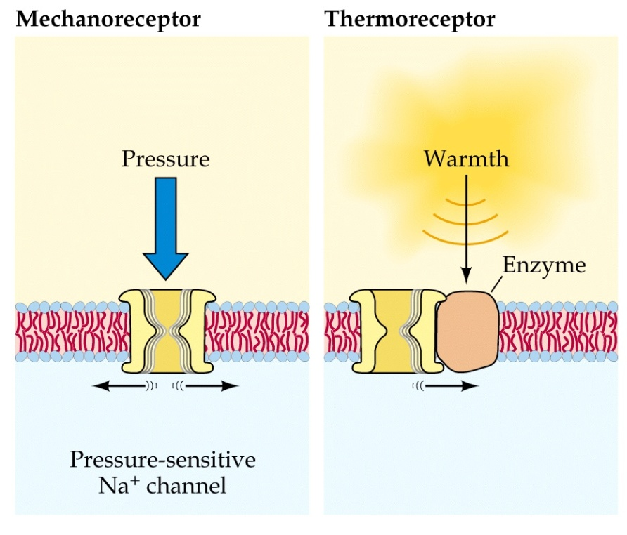
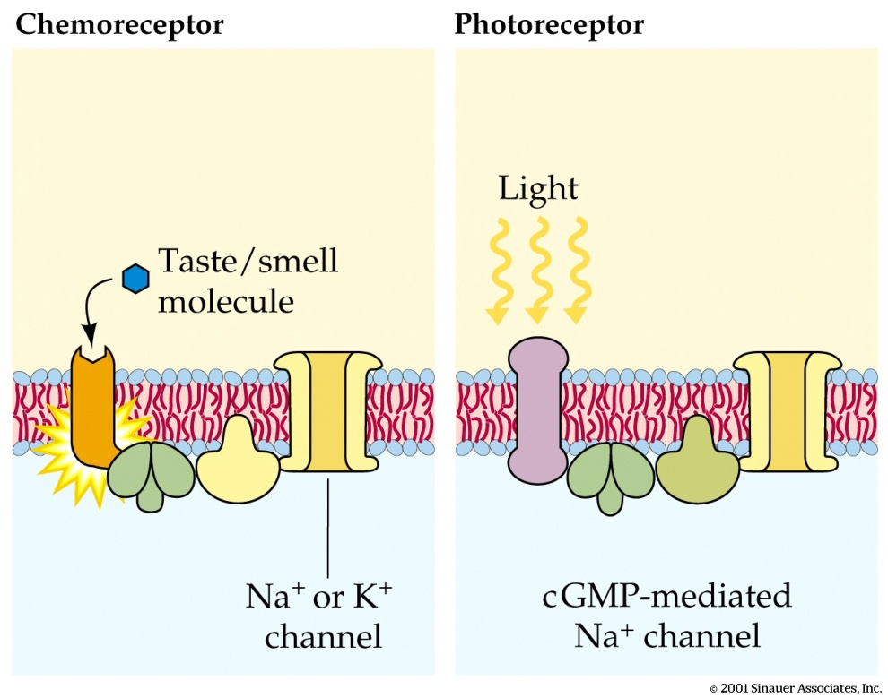
Types of sensory receptor cells
Not shown: nociceptor (tissue damage)
Notes:
Mechanoreceptors: respond to physical deformation from mechanical energy ie, pressure, touch, stretch, motion, sound
Thermoreceptor: respond to heat or cold
Electroreceptor: respond to electric currents in water
Chemoreceptor: respond to total solute concentrations, specific molecular concentrations, or airborne chemical molecules
Photoreceptor: respond to radiant energy (in humans, visible light)
What isn’t shown is a nociceptor: harmful stimuli such as tissue injury

Slide 5
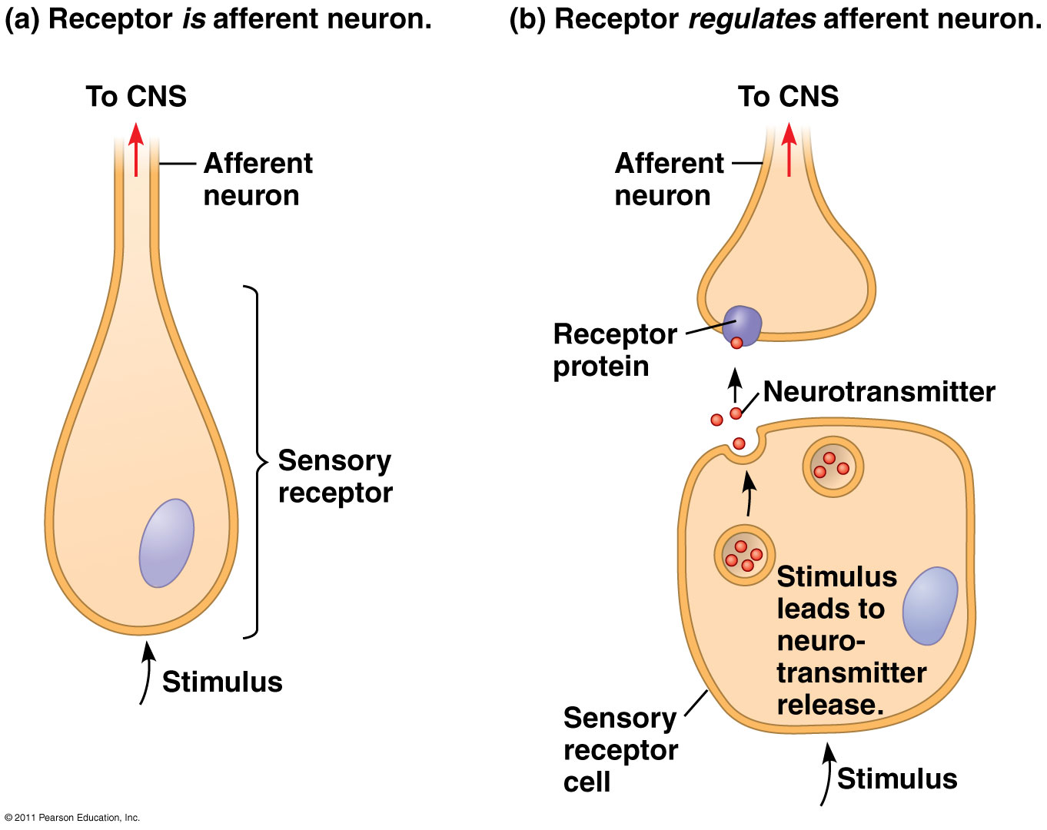
Types of sensory receptor cells
Notes:
Mechanoreceptors: respond to physical deformation from mechanical energy ie, pressure, touch, stretch, motion, sound
Thermoreceptor: respond to heat or cold
Electroreceptor: respond to electric currents in water
Chemoreceptor: respond to total solute concentrations, specific molecular concentrations, or airborne chemical molecules
Photoreceptor: respond to radiant energy (in humans, visible light)
What isn’t shown is a nociceptor: harmful stimuli such as tissue injury

Slide 6
Sensory reception and transduction: touch, hearing, pain, sight, smell (Questions you should answer for each system)
What is the stimulus?
What type of receptor?
Receptor cell or specialized neuron
How is the stimulus transduced into a change in membrane potential?
What happens when the stimulus is recognized by the receptor?
How is membrane potential affected in the receptor cell?
Action potentials are digital, sensory information is analog. How is the intensity/degree/magnitude of the stimulus relayed to CNS?

Slide 7
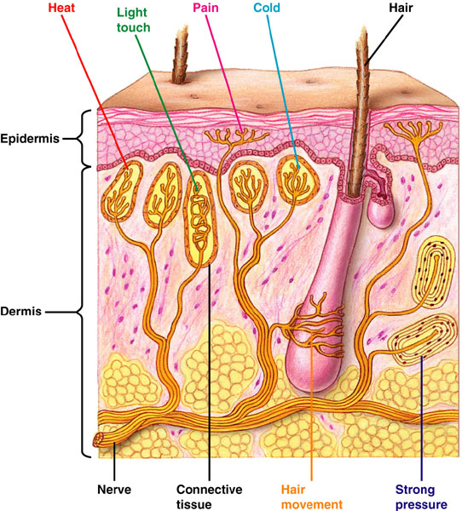
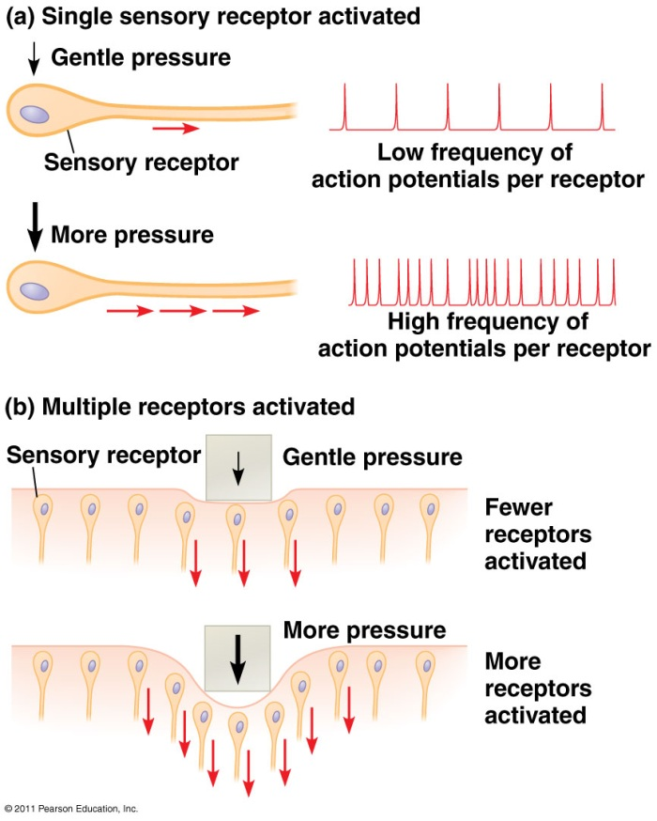
Mechanoreceptors: Touch
sense physical deformation from pressure or stretch
three mechanisms for sensing amount of pressure
Notes:
how transmit info about “more” pressure through action potentials which all have same speed/strength?

Slide 8
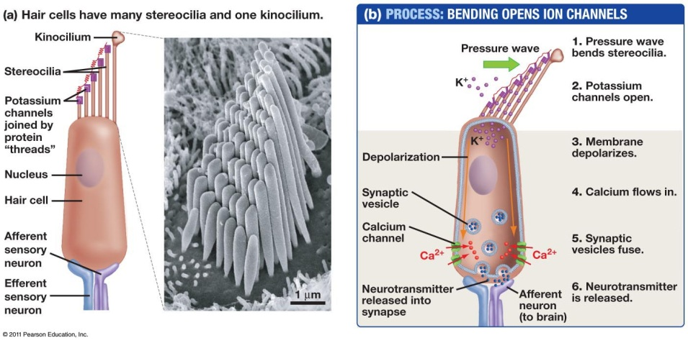
Mechanoreceptors: hearing
Pressure of sound waves moves sterocilia and kinocilium
If bent toward kinocilium – depolarization occurs
Common theme of pressure cells = bending opens ion channels
Hair cells bathed in potassium rich extracellular fluid
Notes:
Pressure of sound waves moves sterocilia and kinocilium
If bent toward kinocilium – depolarization
Common theme of pressure cells = bending opens ion channels
Hair cells bathed in potassium rich extracellular fluid

Slide 9
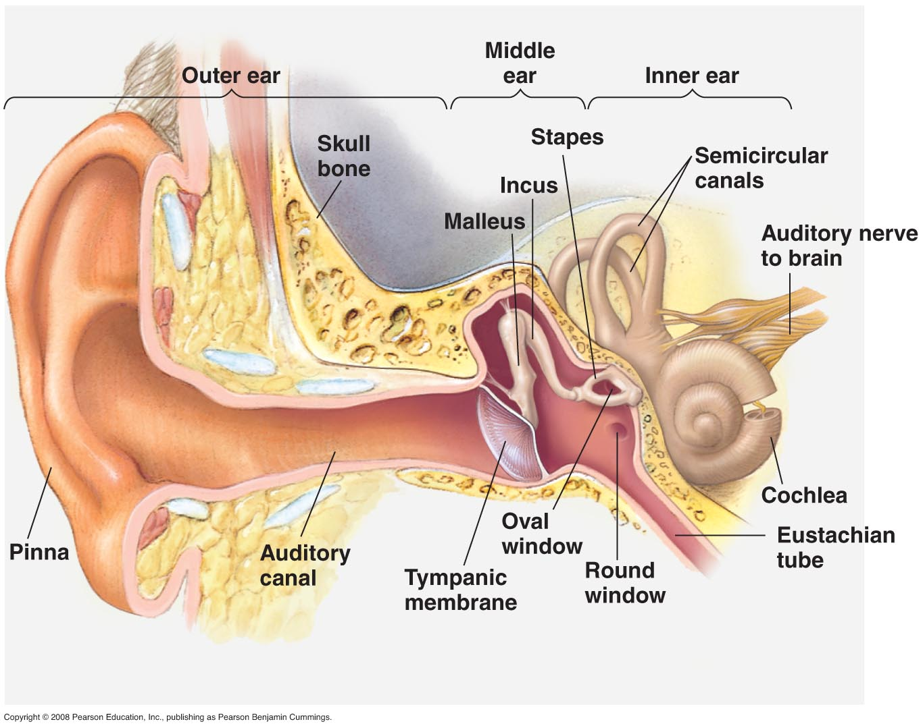
Structure of the human ear
Ossicles vibrate fluid-filled choclea
Amplifies signal
Notes:
Middle ear cavity amplifies signal
Moves into fluid-filled cochlea
Zoom in on cochlea
Cochlea is where sensors are
Hair cells, attached to sensory neurons
Hair cells are not neurons but depolarize and release nts at synapse with neurons

Slide 10
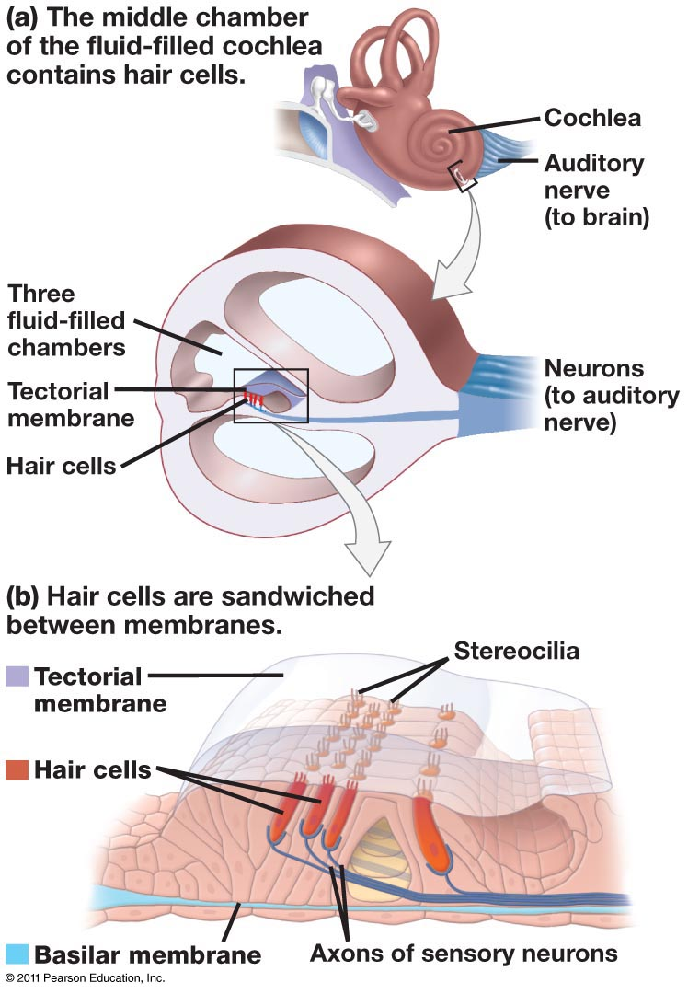
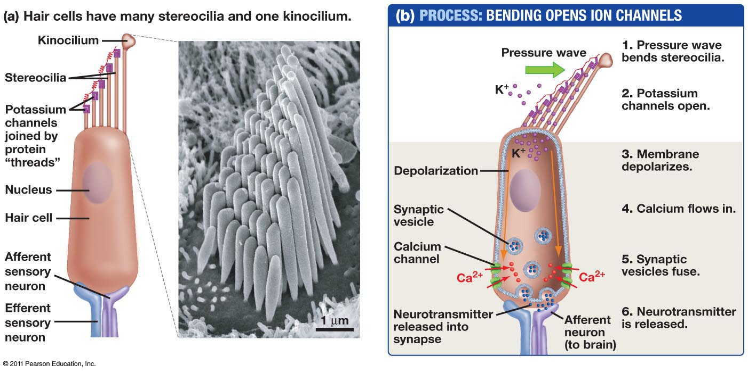
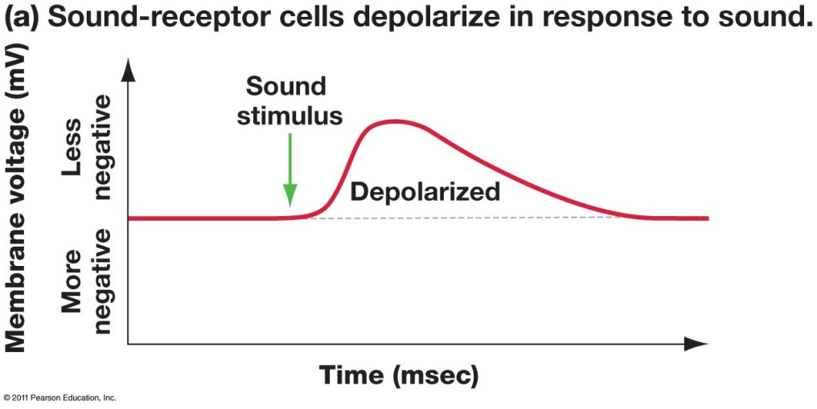
Mechanoreceptors: hearing
Notes:
Zoom in on area where sensory cells are
Remind same type of cell as touch – pressure
Pressure results in depolarization of membrane, release of nt, transmission to afferent neuron
Hair cells are responsible for mammalian auditory sensitivity. We “hear” pressure waves in air or water. The number of waves per second is the frequency of the sound, and we perceive different frequencies as different pitches of sound

Slide 11
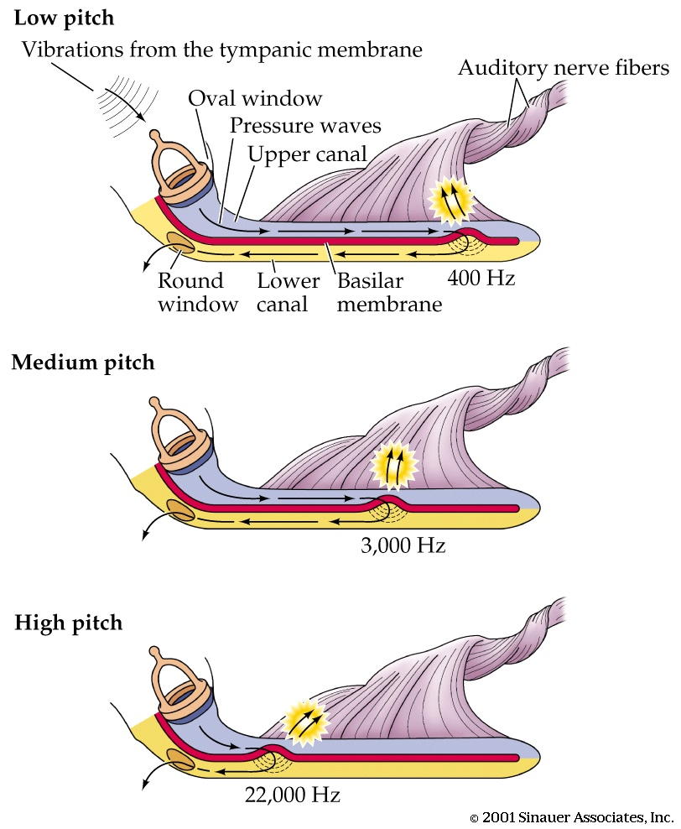
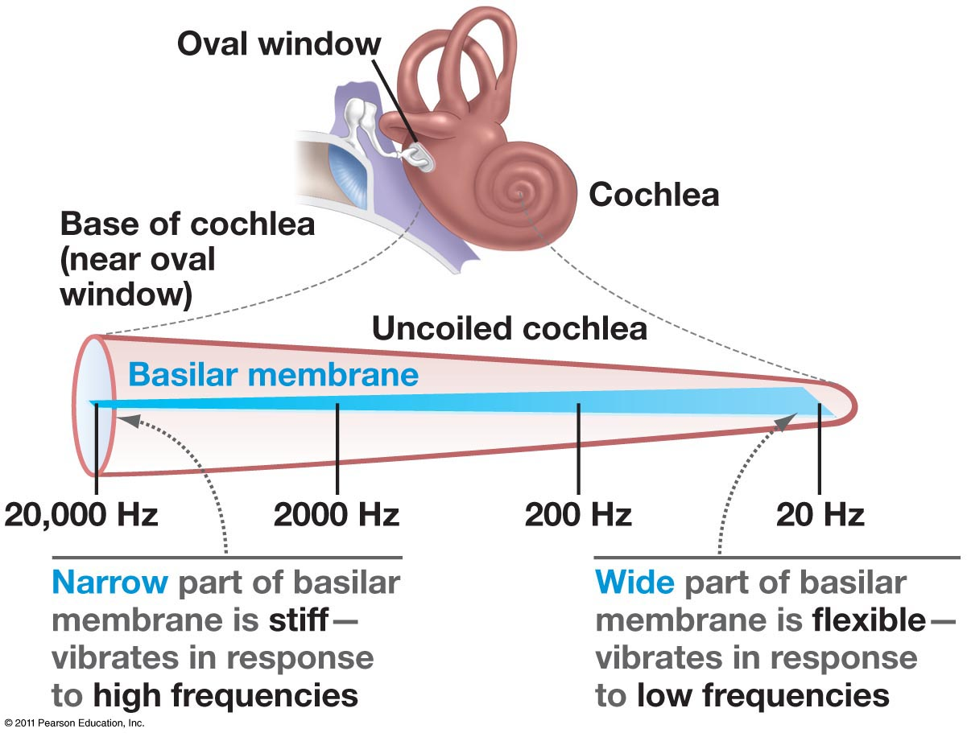
Interpreting different pitches: different hair cells respond to different sound frequencies based on their location in the cochlea
Notes:
Unwind cochlea, this is what you’d see
Hair cells are responsible for mammalian auditory sensitivity. We “hear” pressure waves in air or water. The number of waves per second is the frequency of the sound, and we perceive different frequencies as different pitches of sound

Slide 12
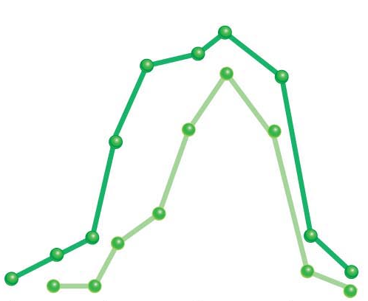
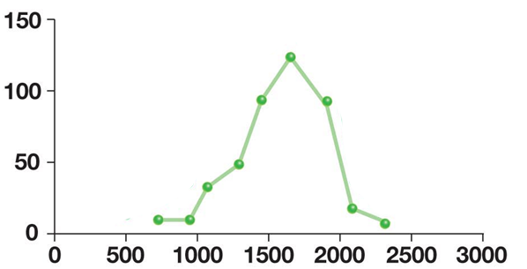
How does the sensory neuron transmit information about volume?
For one specific hair cell at one specific site on the basilar membrane…
Loud sound
Soft sound
Number of action
potentials per second
Frequency (Hz)
Notes:
What can you change on this graph?

Slide 13
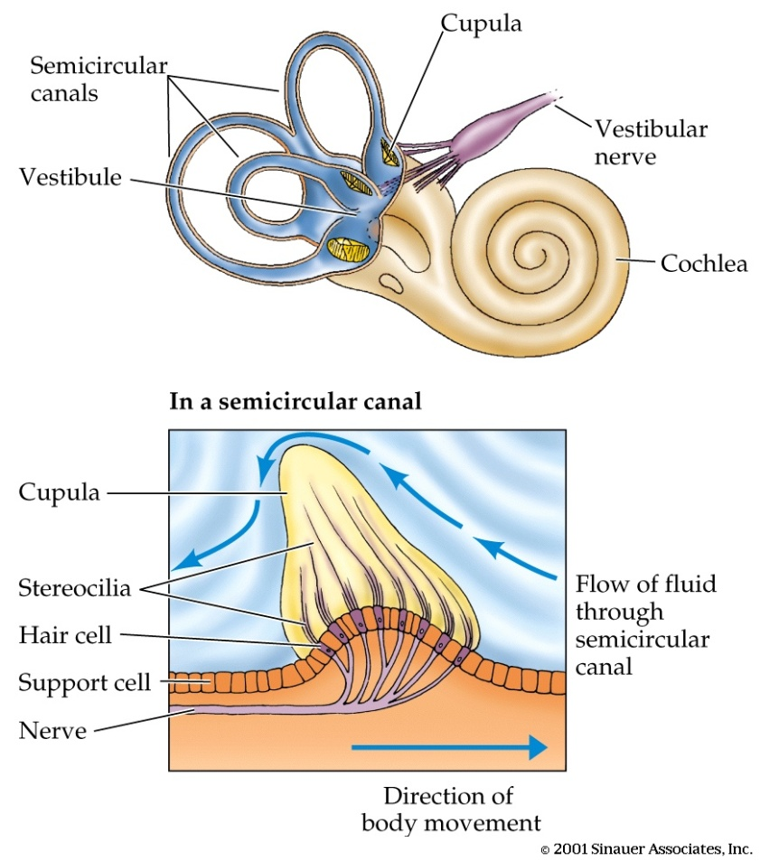
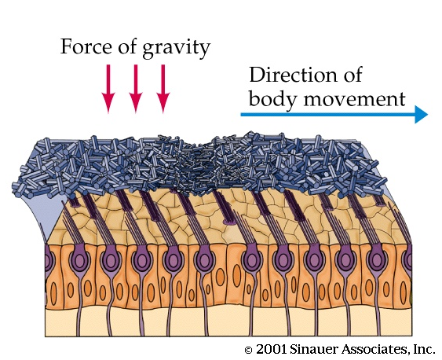
Animals also use hair cells to respond to gravity and momentum (balance)
Fluid in the semicircular canals moves in response to shifts in body axes
Hair cells project into a gelatinous matrix containing calcium carbonate particles, “ear stones”
The hair cells are stimulated when the fluid and force of gravity shift the position of the gelatinous material
In the vestibule, otoliths
register gravity
Notes:
Fish use hair cells along their lateral lines to detect changes in water & movement
Invertebrates use hair cells to signal position of body with respect to gravity
Mammals use the semicircular canals and vestibule in the inner ear to sense gravity & momentum
Statolith & otolith are calcium-rich structures

Slide 14
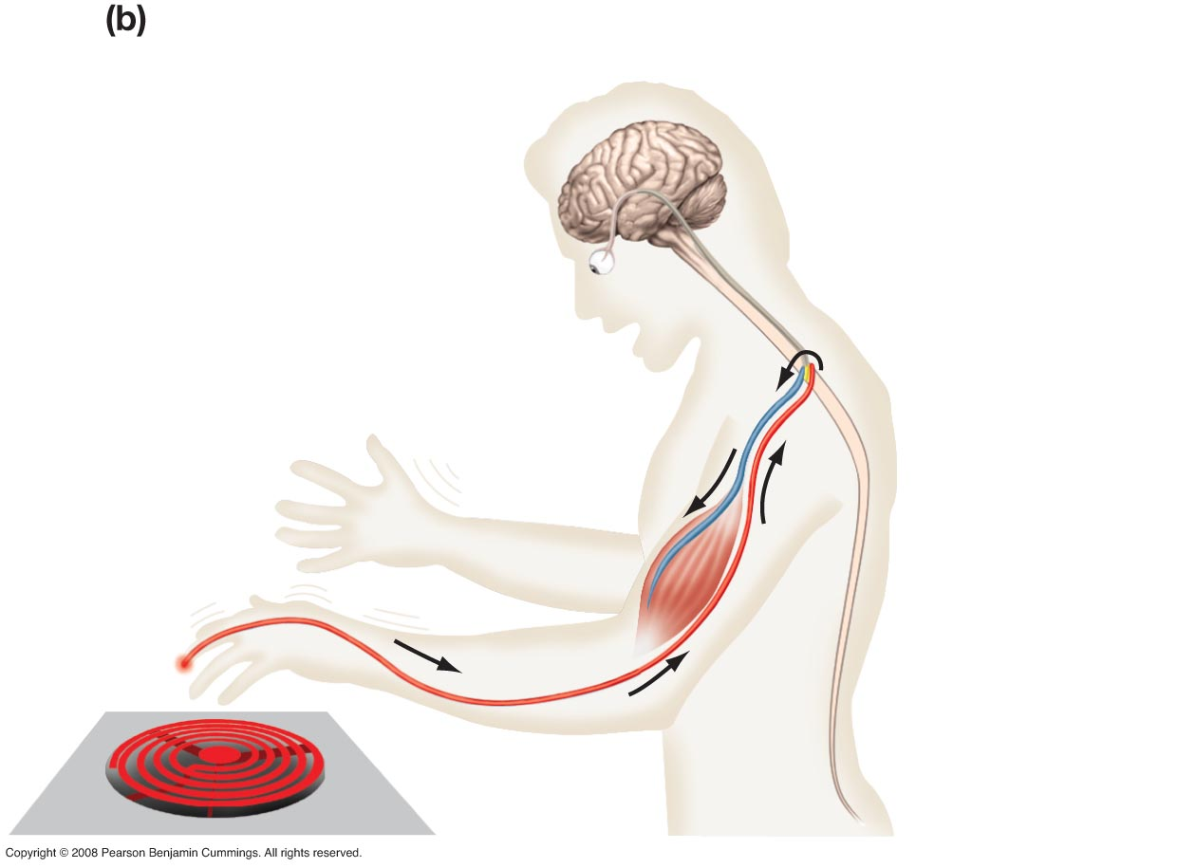
Reflex arc
7
6
3
4
1
5
2
Freeman 2e 45.1

Slide 15
Nociceptors: Pain
Any type of tissue injury:
Extreme heat or cold
Extreme mechanical deformation
Noxious chemicals
Often free nerve endings
Notes:
Nociceptors have two different types of axons. The first are the Aδ fiber axons. They are myelinated and can allow an action potential to travel at a rate of about 20 meters/second towards the CNS. The other type is the more slowly conducting C fiber axons. These only conduct at speeds of around 2 meters/second.^{[5]} This is due to the light or non-myelination of the axon. As a result, pain comes in two phases. The first phase is mediated by the fast-conducting Aδ fibers and the second part due to (Polymodal) C fibers. The pain associated with the Aδ fibers can be associated to an initial extremely sharp pain. The second phase is a more prolonged and slightly less intense feeling of pain as a result of the acute damage. If there is massive or prolonged input to a C fiber, there is a progressive build up in the spinal cord dorsal horn; this phenomenon is similar to tetanus in muscles but is called wind-up. If wind-up occurs there is a probability of increased sensitivity to pain.^{[6]}

Slide 16
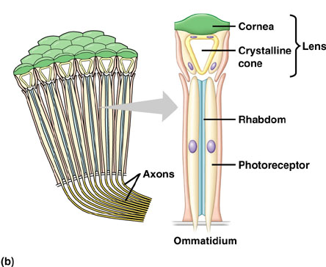
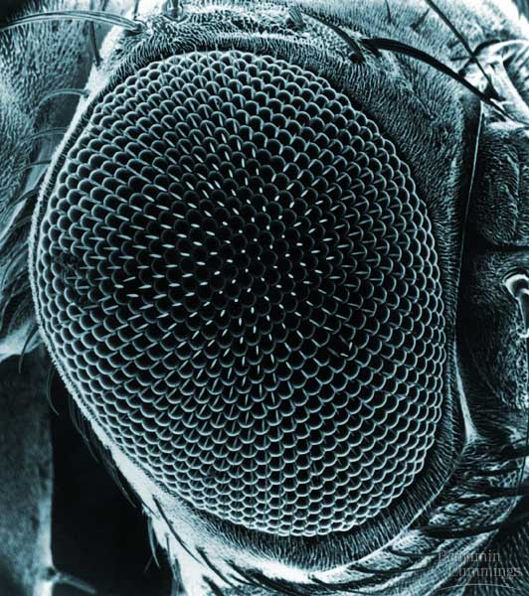
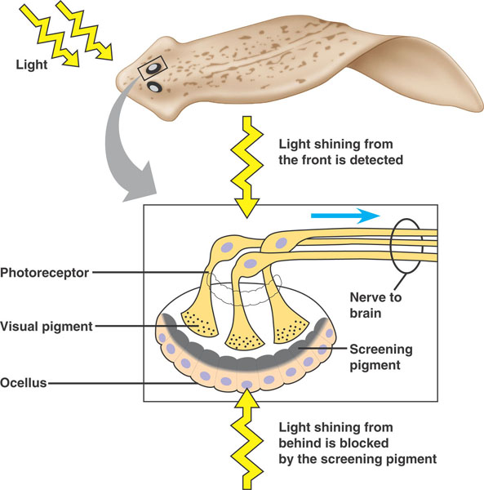
Photoreceptors: Sight
Photoreception varies from the eye cups of flatworms, which can sense the direction of a light source,
to the compound (multiple lenses) eyes of arthropods, which can detect shapes and patterns,
to the simple (single lens) eyes of cephalopods and vertebrates that form images
All photoreceptors contain similar pigment molecules that absorb light
Evolution of the eye:
http://www.youtube.com/watch?v=mb9_x1wgm7E
Notes:
All photoreceptors contain similar pigment molecules that absorb light
Evolution of eye video from Richard Dawkins: http://www.youtube.com/watch?v=mb9_x1wgm7E

Slide 17
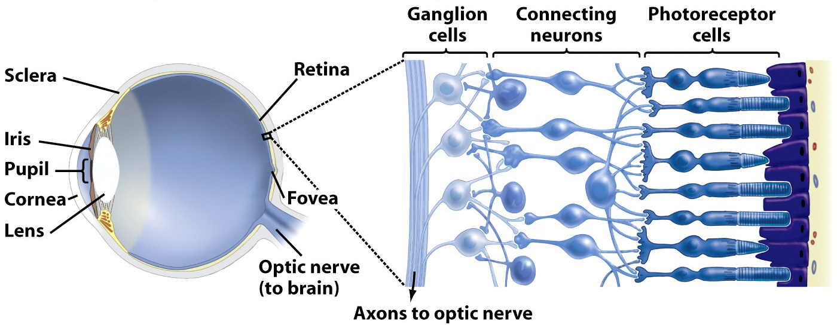
The Vertebrate Eye
Sclera: tough outer tissue (white of the eye)
Cornea: transparent sheet of connective tissue
Iris: pigmented muscle that controls amount of light entering eye
Pupil: hole in center of iris
Lens: clear, curved structure that focus light (by bending, not by moving) in combination with cornea
Retina: thin layer of photoreceptor cells and neurons
Held in place by pigmented epithelium (dark purple structure above)
Photoreceptor cells: light-detecting sensory cells
Bipolar cells: intermediate connecting neurons
Ganglion cells: neurons whose axons project to the brain via the optic nerve
Fovea: site of retina with only cones, area of highest visual resolution
Optic nerve: axons of the ganglion cells

Slide 18
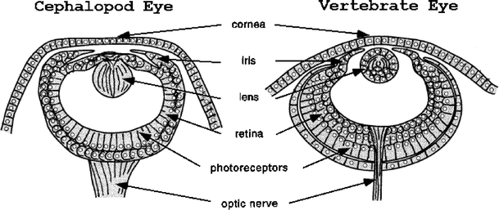
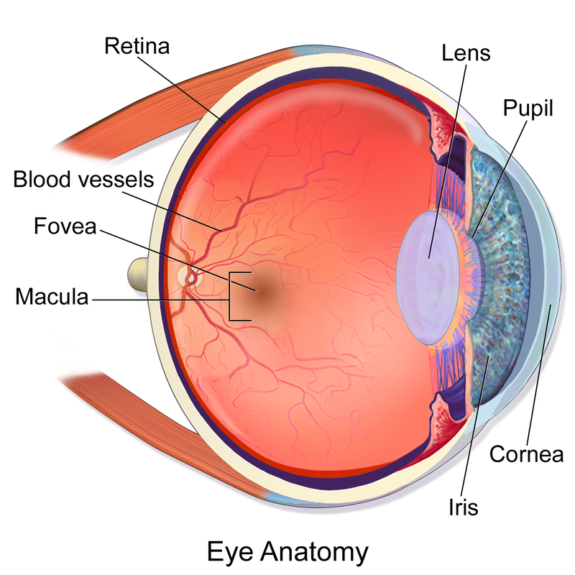
Cephalopod vs vertebrate eye
Cephalopod eyes move the lens to focus rather than changing shape, as in the vertebrate eye
Unlike cephalopod eyes, vertebrate eyes have an ‘inverted’ retina, where blood vessels and nerves are in front of the light-sensing cells
Problems arising from this including: blind spot, macular degeneration (macula contains fovea), detached retina
Notes:
Medical, evolutionary, and Christian perspective (all in one): http://christadelphianevolution.blogspot.com/2014/11/suboptimal-design-and-problem-it-poses.html

Slide 19
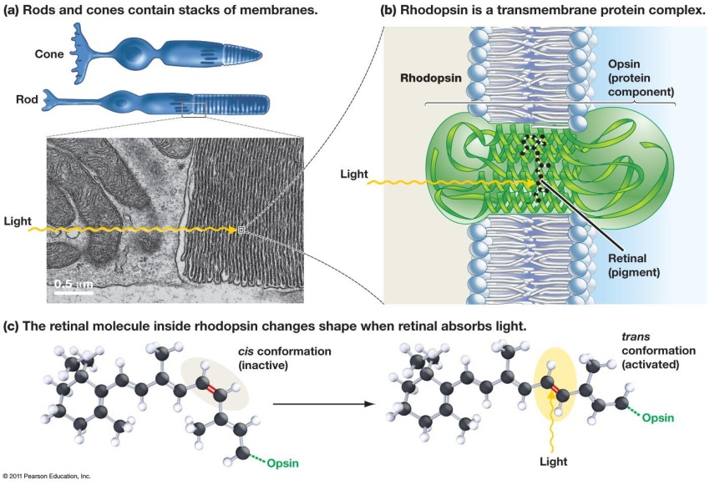
Light detection: retinal
Notes:
Change in retinal shape results in in change in opsin shape, which alters flow of ions across the cell membrane

Slide 20
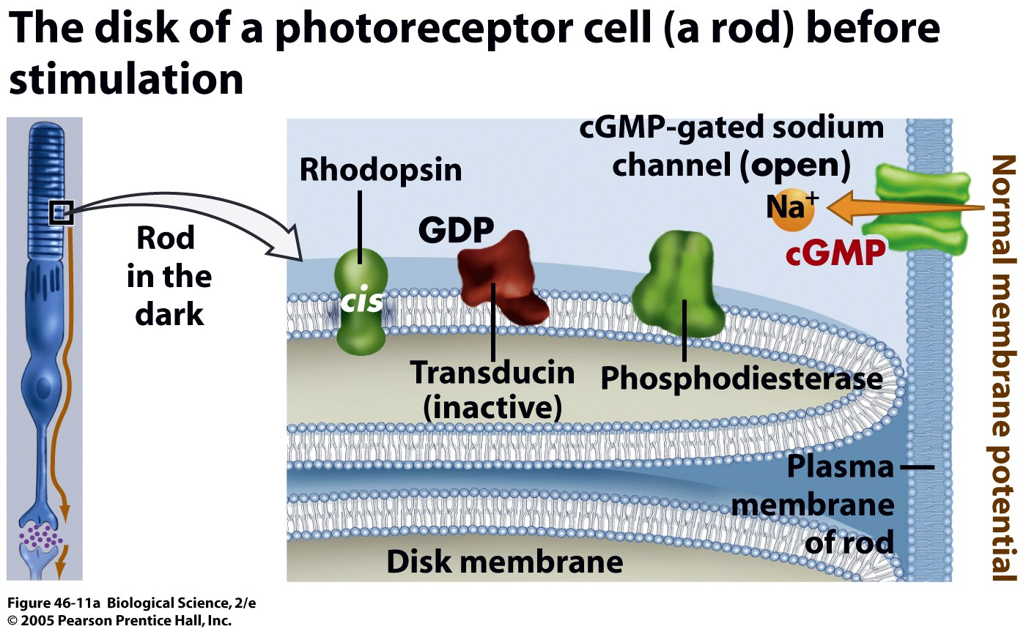
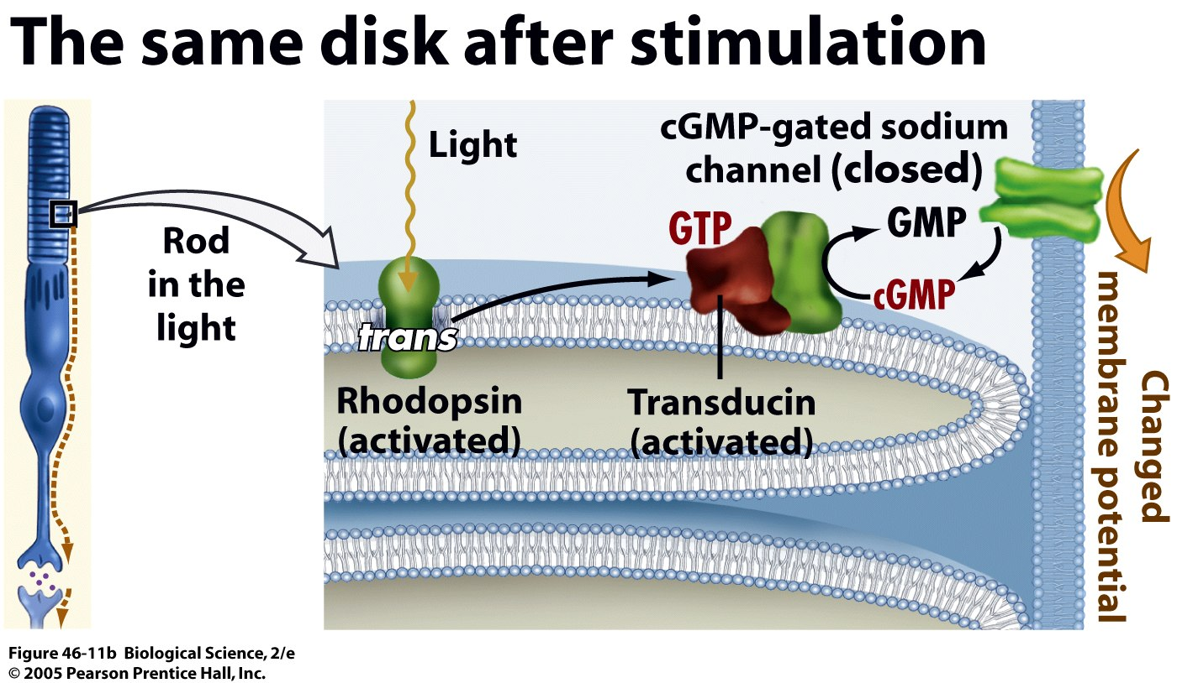
Signal transduction of light
What is happening to membrane potential?
What is happening to membrane potential?

Slide 21
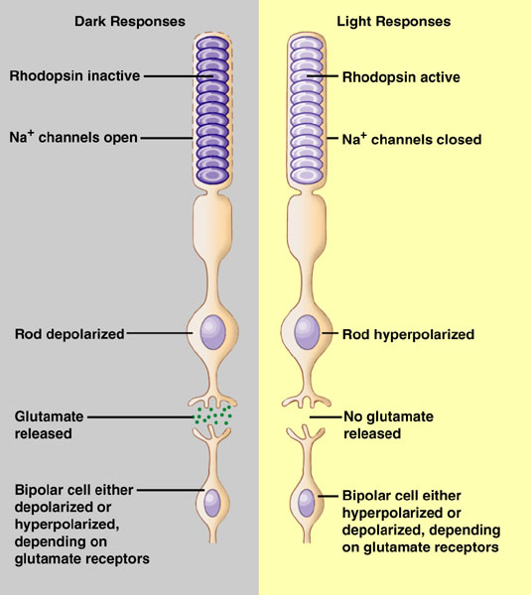
Light results in hyperpolarization
Dark: Rhodopsin is inactive, the cell membrane is permeable to sodium and depolarized. The rod cell releases glutamate at synapses with bipolar cells
Light: Light activates rhodopsin, rod cell membrane closes sodium channels and cell is hyperpolarized. Decrease in release of glutamate
Notes:
Absorption of light by retinal is the first step in a cascade of intracellular events, a signal transduction pathway that leads to a change in the receptor potential of the photoreceptor cell.
In absence of light stimulation, enzymes convert trans form back to cis form, which then recombines with opsin.

Slide 22
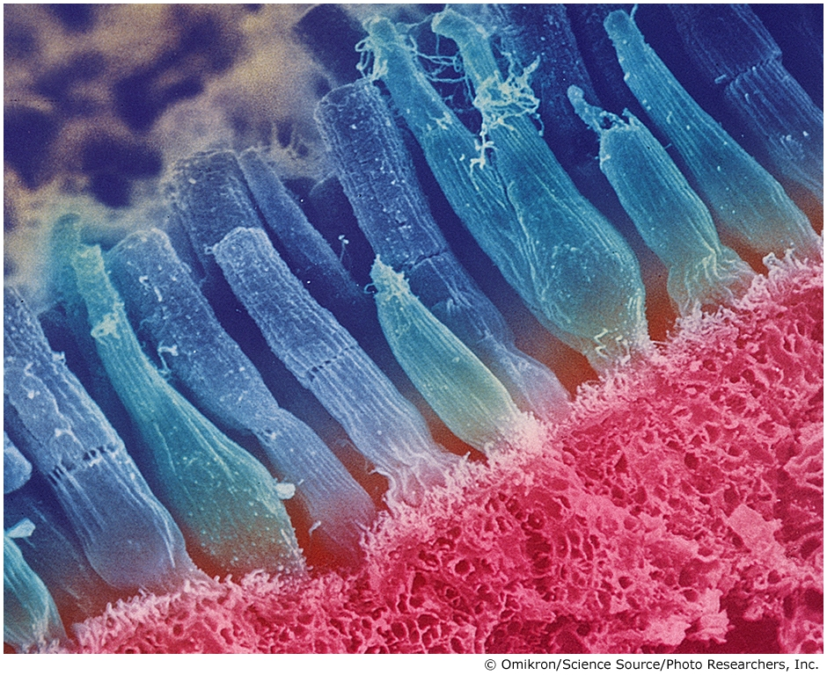
Rods vs Cones
Rods
stimulated in low light levels
no color detection
greatest density at retina periphery
useful for detecting movement
Cones
require high light conditions
perceive color
greatest density at fovea
useful for focusing on important detail
Rods and Cones. This scanning electron micrograph of photoreceptors in the retina of a mud puppy (an amphibian) shows cylindrical rods and tapered cones.

Slide 23
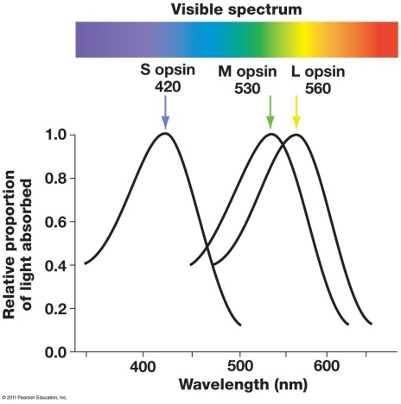
Color detection: opsins
Different opsins are sensitive to different wavelengths of light
All opsins contain the same retinal

Slide 24
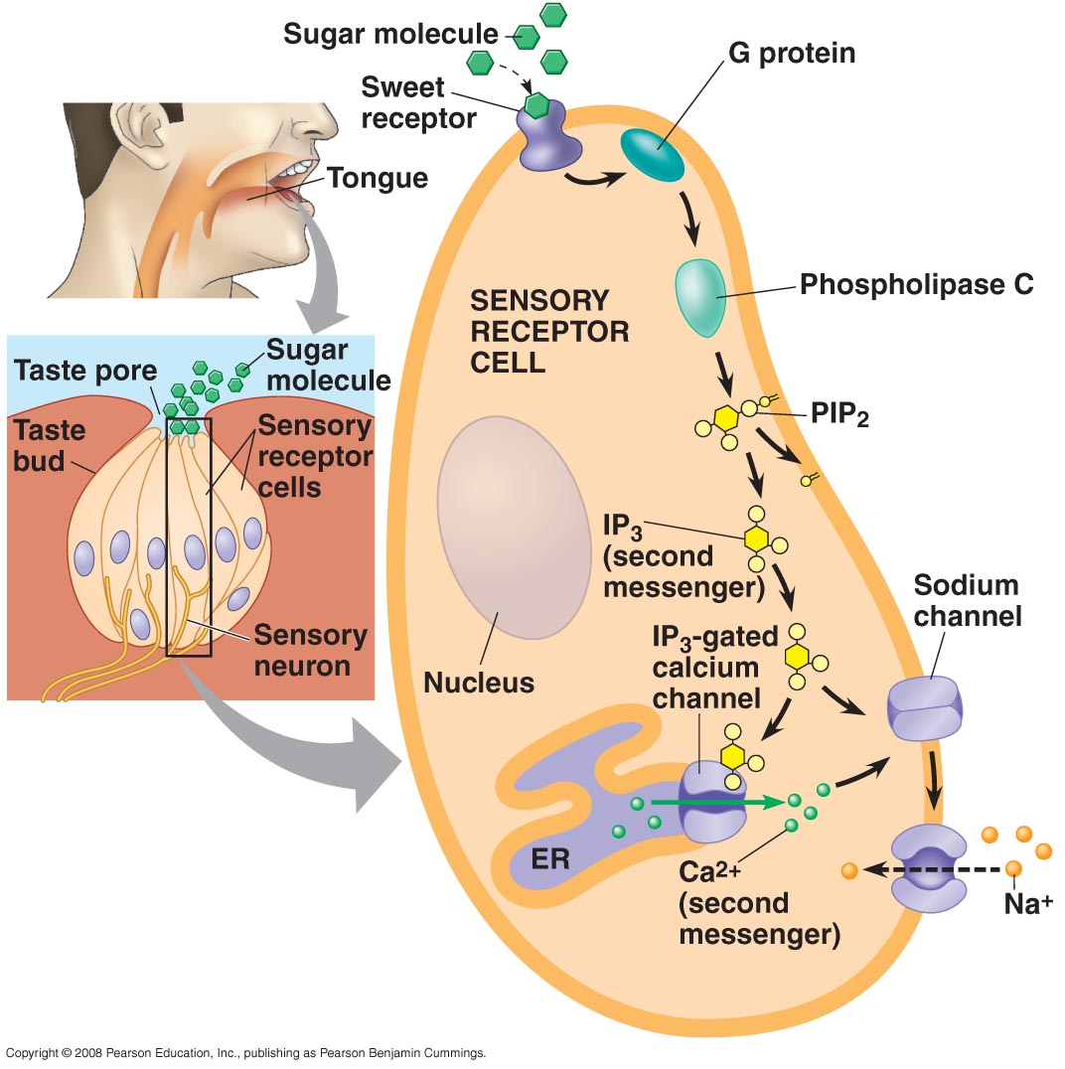
Chemoreceptors: Taste
Specific molecules bind to receptor proteins in the membranes of the microvilli.
The cell is depolarized (pathway varies with receptor cell), which stimulates release of neurotransmitter.
The neurotransmitter is received by dendrites of nearby sensory neurons, the action potential fires and is carried to the CNS.

Slide 25
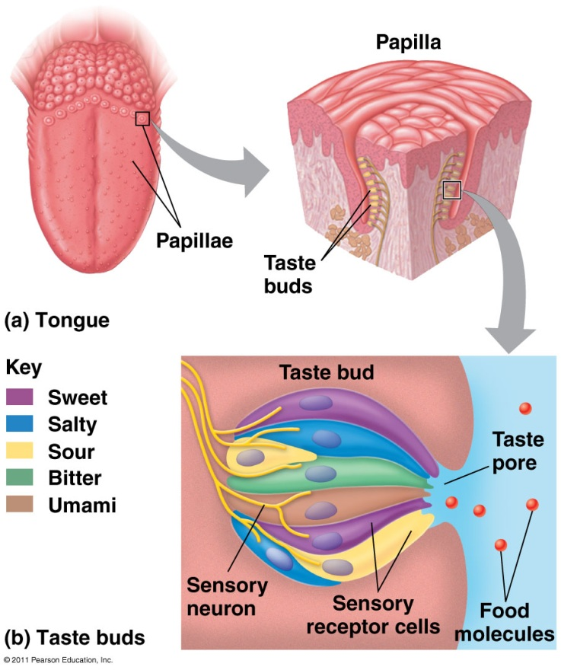
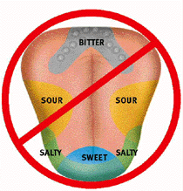
Detection of different tastes
The “taste map” has been debunked since 1974
http://www.livescience.com/7113-tongue-map-tasteless-myth-debunked.html
Spiciness is detected by chemical-sensitive nociceptors

Slide 26
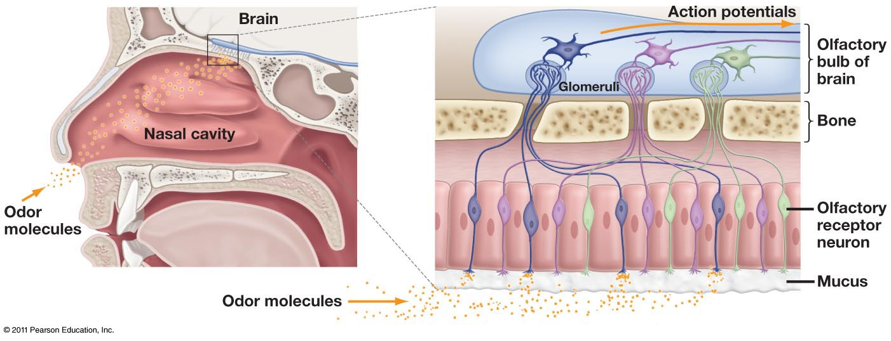
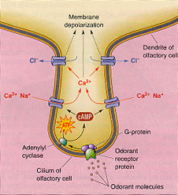
Chemoreceptors: Smell
Odorant molecules diffuse through mucus film at roof of nasal opening.
Odorants bind to specific receptor proteins which activate a G-protein, stimulating sodium channels to open.
Action potential is fired and carried to olfactory bulbs in brain.
How is signal transduction different between taste and smell?
Notes:
Taste: sensory cell synapsed with sensory neuron
Smell: sensory cell IS sensory neuron

Slide 27
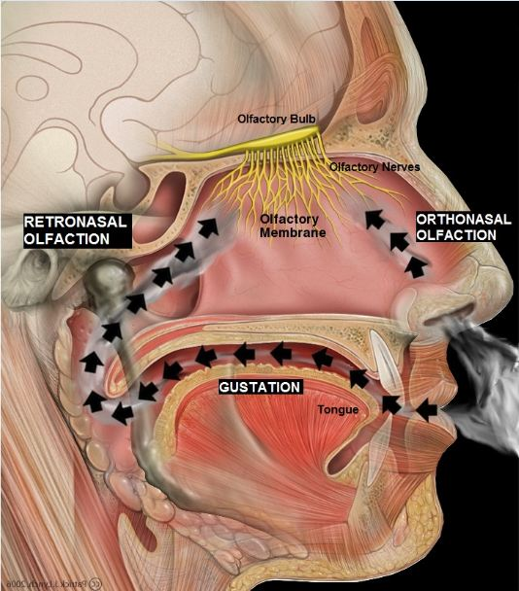
Flavor: Taste and Smell
Our ability to detect and interpret flavor is due to a combination of our gustatory and olfactory senses.
Taste receptors are responsible for our sense of how salty, sweet, bitter, sour, or savory a food is.
Olfactory receptors (via retronasal olfaction) are responsible for the flavor of a food.

